Slide 1

6th Semester
Major Project Phase – I (CSEP23605)
Review 2
Group No. | G14 | Project ID | P43
Project Title | Implementation of a Secure CI/CD Pipeline Using DevOps Tools
Student Name | Vignesh P | USN | 1GA23CS193
 | Revanth Kumar T S |  | 1GA23CS137
 | Sanket |  | 1GA23CS148
 | Shakthi Vel K |  | 1GA23CS151
Guide Name | Prof. Sameena H S , Assistant Professor

Slide 2
Agenda
Problem Statement
Literature Survey
Objectives
Proposed System
Methodology
System Architecture
Design Diagrams
Requirements Specification
Implementation
Results
Plagiarism report of Project Report and Conference Paper
Proof of Submission
Conclusion
References
Plan of Action for Phase – II
Time Line for Phase - II

Slide 3
Problem Statement
Security vulnerabilities are often detected after deployment
This leads to:
Increased risk of cyberattacks
High remediation and maintenance costs
Delays in software releases
Lack of automated security integration in traditional DevOps pipelines
Need for early vulnerability detection in development lifecycle

Slide 4
Literature Survey
Sl. # | Title of the paper and year | Methodology | Merits | Limitations
1 | Implementing and Automating Security Scanning to a DevSecOps CI/CD Pipeline (2023) | Integrates SAST (Snyk) and DAST (StackHawk) in CI/CD to automate vulnerability scanning. | Early vulnerability detection and automated security scanning. | Tested only with limited tools and a demo application.
2 | Automated Security Findings Management: A Case Study in Industrial DevOps (2024) | Uses Security Flama to automate collection and management of security findings in DevOps pipelines | Improves visibility of security issues. | Requires manual input and good interface design.
3 | Challenges Affecting the Successful Adoption of DevOps Practices: A Systematic Literature Review (2024) | Systematic literature review using PRISMA method to analyze DevOps adoption challenges. | Identifies major DevOps adoption challenges. | Based only on literature, not real-world experiments.

Slide 5
Literature Survey
Sl. # | Title of the paper and year | Methodology | Merits | Limitations
4 | Enhancing Smart Contract Security Through DevSecOps: An Adaptive Approach for Vulnerability Detection (2025) | Uses DevSecOps pipeline with AI-based vulnerability detection techniques like static analysis, fuzzing, and symbolic execution. | Improves security by detecting vulnerabilities early in CI/CD. | Focused mainly on blockchain smart contracts.
5 | Cybersecurity in DevOps Environments: A Systematic Literature Review (2025) | Systematic Literature Review analyzing cybersecurity threats and mitigation strategies in DevOps. | Identifies major DevOps security threats and mitigation methods. | Lacks strong empirical validation in many studies.
6 | Effort Estimation in Agile and DevOps: A Systematic Literature Review of Stakeholder Dissatisfaction (2025) | Systematic Literature Review (SLR) analyzing factors affecting effort estimation in Agile–DevOps environments. | Identifies key estimation challenges and improvement techniques. | Based mainly on literature analysis, limited real-world validation.

Slide 6
Literature Survey
Sl. # | Title of the paper and year | Methodology | Merits | Limitations
7 | Extensive Review of Threat Models for DevSecOps (2025) | Survey study reviewing threat models such as STRIDE, PASTA, OCTAVE, TRIKE, and VAST for DevSecOps security. | Literature-based review of threat modeling approaches. | Mainly conceptual review with limited experimental validation
8 | Empirical Investigation of Key Enablers for Secure DevOps Practices (2025) | Multivocal Literature Review + questionnaire survey analyzed using PLS-SEM to evaluate DevSecOps enablers. | Identifies 35 key enablers mapped to CAMS (Culture, Automation, Measurement, Sharing). | Results depend on survey responses and may vary across organizations.
9 | Building Resilient CI/CD Pipelines: A DevOps Security-First Framework (2025) | Implements a secure CI/CD pipeline using AWS, Terraform, Jenkins, Docker, and ArgoCD with automated security scanning and monitoring. | Improves deployment speed, security scanning, and system monitoring. | Implementation focused on a specific cloud setup and tool stack.

Slide 7
Literature Survey
Sl. # | Title of the paper and year | Methodology | Merits | Limitations
10 | Enhancing DevOps Continuous Monitoring Phase: Hybrid Intrusion Detection and Ensemble Learning System (HIDELS) (2026) | Proposed HIDELS model integrating DevOps continuous monitoring with ML algorithms (LR, kNN, DT, NB, SVM) and ensemble learning for intrusion detection. | Achieves high detection accuracy (~99%) and improves security monitoring in DevOps pipelines. | Requires high computational resources and complex model training for ensemble learning.

Slide 8
Objectives
To design and implement a secure CI/CD pipeline
To integrate security testing tools into DevOps workflows
To identify and mitigate vulnerabilities at early stages of development
To reduce security risks and remediation costs
To ensure faster and secure software delivery

Slide 9
Proposed System
Overview of the new solution :
A Secure DevSecOps CI/CD pipeline that automates code build, security scanning, deployment, and monitoring using tools like Jenkins, Docker, Kubernetes, and cloud platforms.
Advantages over existing systems :
Early vulnerability detection through integrated security scanning.
Automated build and deployment using CI/CD tools.
Continuous monitoring using Prometheus and Grafana.

Slide 10
Methodology
Version Control: Source code is managed and stored using Git and GitHub.
Continuous Integration: Jenkins automates the build and testing process.
Security Testing: SonarQube (SAST), OWASP ZAP (DAST), and Trivy detect vulnerabilities in code and containers.
Containerization & Deployment: Applications are packaged with Docker and deployed using Kubernetes on cloud platforms.
Monitoring: Prometheus and Grafana are used for continuous monitoring and logging of system performance.

Slide 11
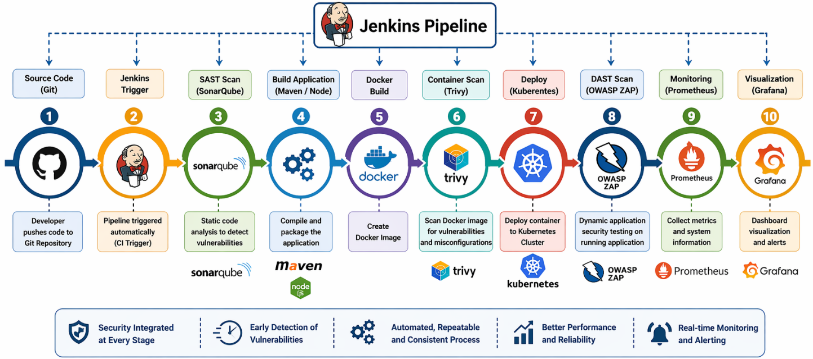
System Architecture
The DevSecOps CI/CD architecture automates the software lifecycle where code pushed to GitHub triggers Jenkins for build, testing, and security scanning using SonarQube and OWASP ZAP/Trivy.
The application is then containerized with Docker, deployed using Kubernetes on cloud platforms (AWS/Azure), and continuously monitored using Prometheus and Grafana.
Fig.1 : DevSecOps CI/CD architecture

Slide 12
Data Flow Diagram
Definition:
A Data Flow Diagram is a graphical representation that shows how data moves through a system. It illustrates the inputs, outputs, processes, and data stores within a system without showing control flow or timing.

Slide 13
Data Flow Diagram
DFD Level 0 — Context Diagram
The topmost level of DFD that represents the entire system as a single process. It shows how the system interacts with the outside world.
DFD Level 1
Level 1 breaks the single process of Level 0 into major sub-processes (main functions of the system). Data stores are introduced at this level.
DFD Level 2
Level 2 further decomposes each Level 1 process into detailed sub-processes. Each major process from Level 1 gets its own Level 2 DFD.

Slide 14
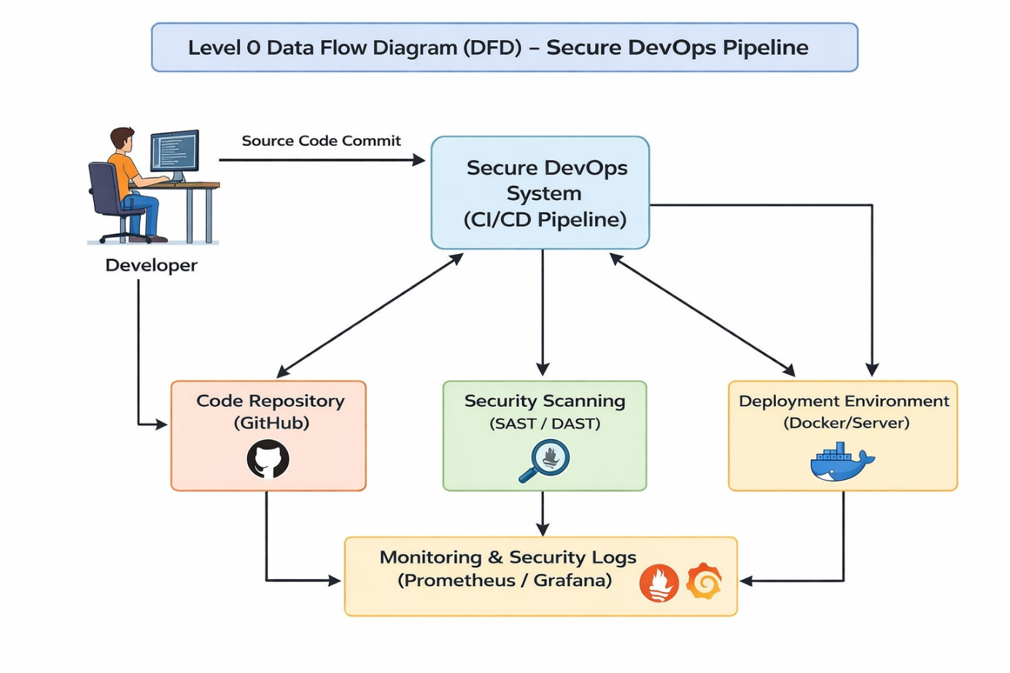
Data Flow Diagram
Level 0 DFD
The Level 0 DFD shows how the developer commits source code to the Secure DevOps CI/CD system, which processes it through code repository, security scanning, and deployment environment.
The system then performs security analysis and deployment while continuously monitoring logs and performance using Prometheus and Grafana.
Fig. 2.1 : DFD Level 0 DevSecOps CI/CD

Slide 15
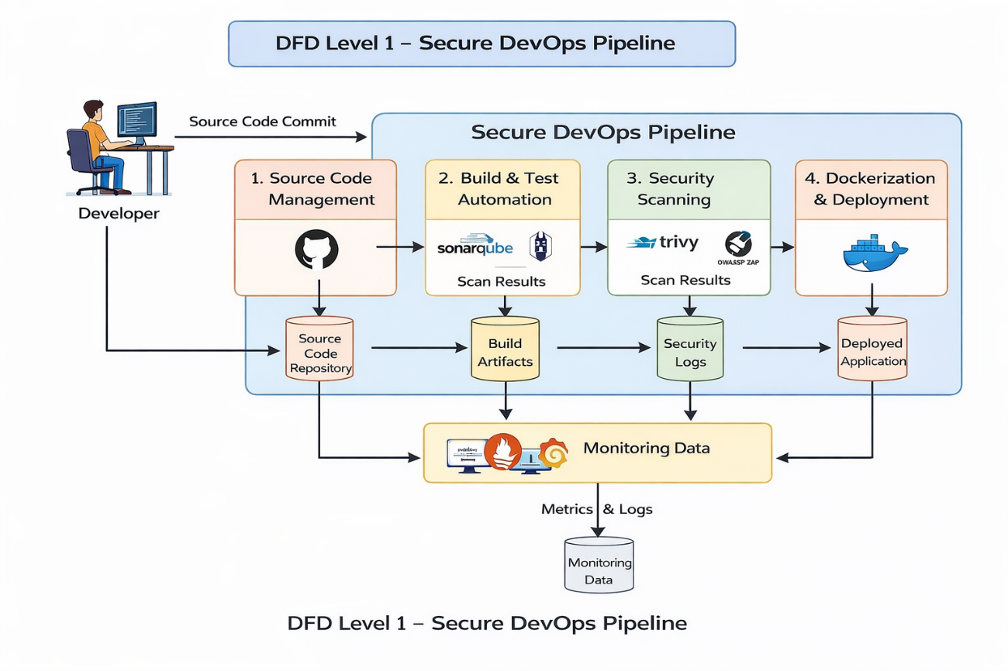
Data Flow Diagram
Level 1 DFD
The Level 1 DFD breaks the Secure DevOps pipeline into four processes: Source Code Management, Build & Test Automation, Security Scanning, and Dockerization & Deployment.
Code from the developer is stored in the repository, tested and scanned for vulnerabilities, deployed as containers, and monitored using Prometheus and Grafana for logs and metrics.
Fig. 2.2 : DFD Level 0 DevSecOps CI/CD

Slide 16
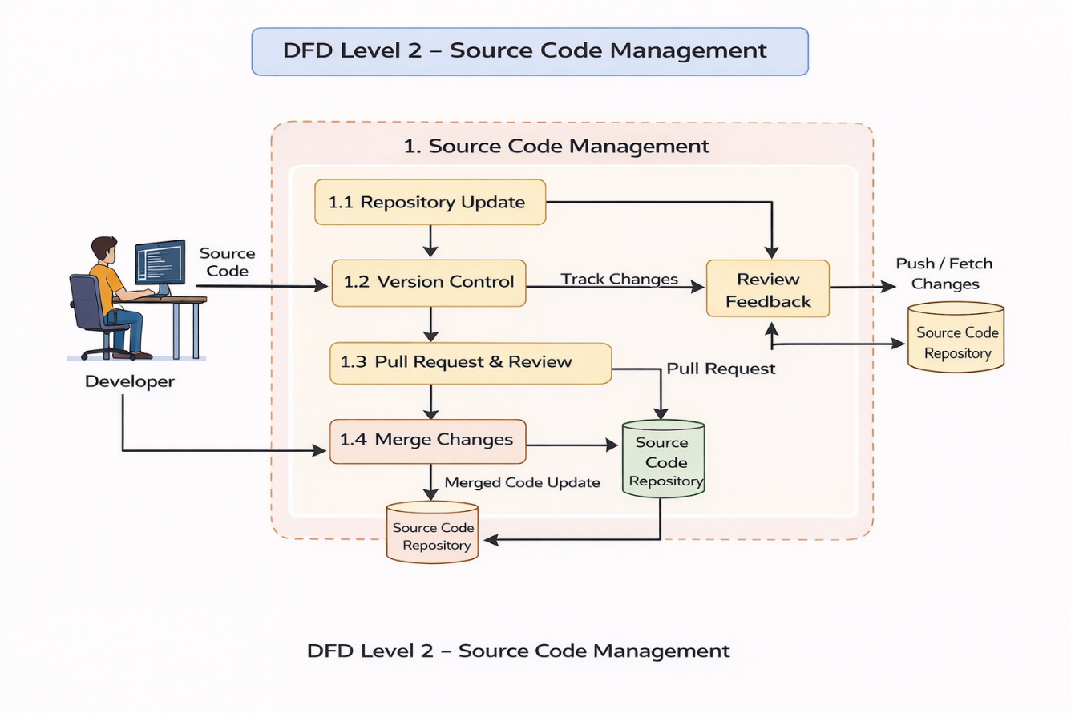
Data Flow Diagram
Level 2 DFD
The Level 2 DFD details the Source Code Management process, where developers update the repository, manage versions, create pull requests, and review code changes.
After review and approval, the code is merged and stored in the source code repository, making it ready for the CI/CD pipeline.
Fig. 2.3 : DFD Level 0 DevSecOps CI/CD

Slide 17
Requirements Specification
Hardware Requirements
Minimum Hardware
Processor: Intel i5 / AMD Ryzen 5
RAM: 8 GB
Storage: 256 GB SSD
Internet connection (for GitHub, updates, plugins)
Recommended Hardware
Processor: Intel i7 / AMD Ryzen 7
RAM: 16 GB
Storage: 512 GB SSD
Virtualization support enabled (for Docker & Jenkins)

Slide 18
Requirements Specification
Software Requirements
Operating System : Windows 11 (64-bit)
Git / GitHub – Version control and source code repository
Jenkins – CI/CD automation tool for build and testing
SonarQube – Static code analysis for vulnerability detection
OWASP ZAP / Trivy – Security scanning tools
Docker – Containerization platform for applications
Kubernetes – Container orchestration for deployment
Prometheus & Grafana – Monitoring and logging tools
AWS / Azure Cloud – Cloud platform for hosting and deployment

Slide 19
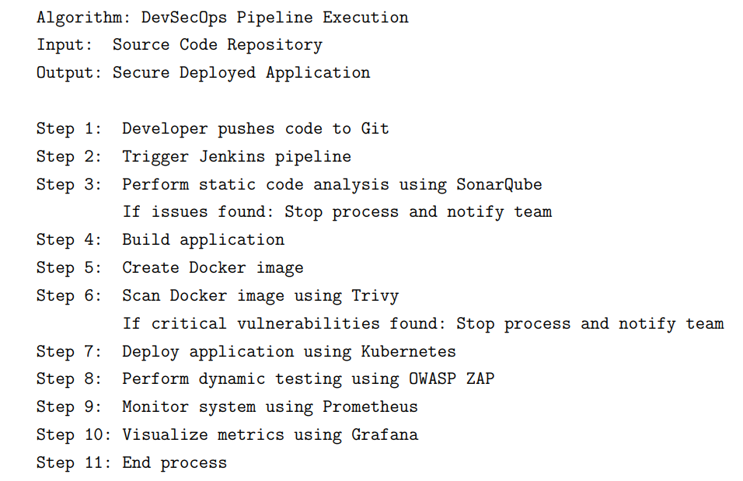
Implementation

Slide 20
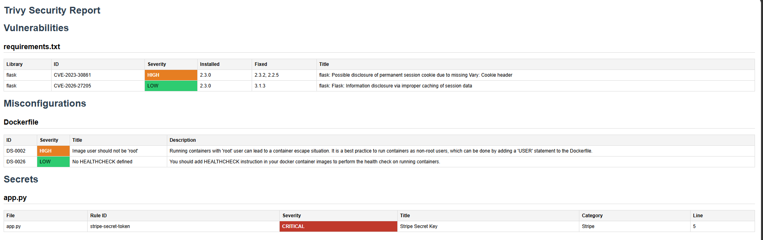
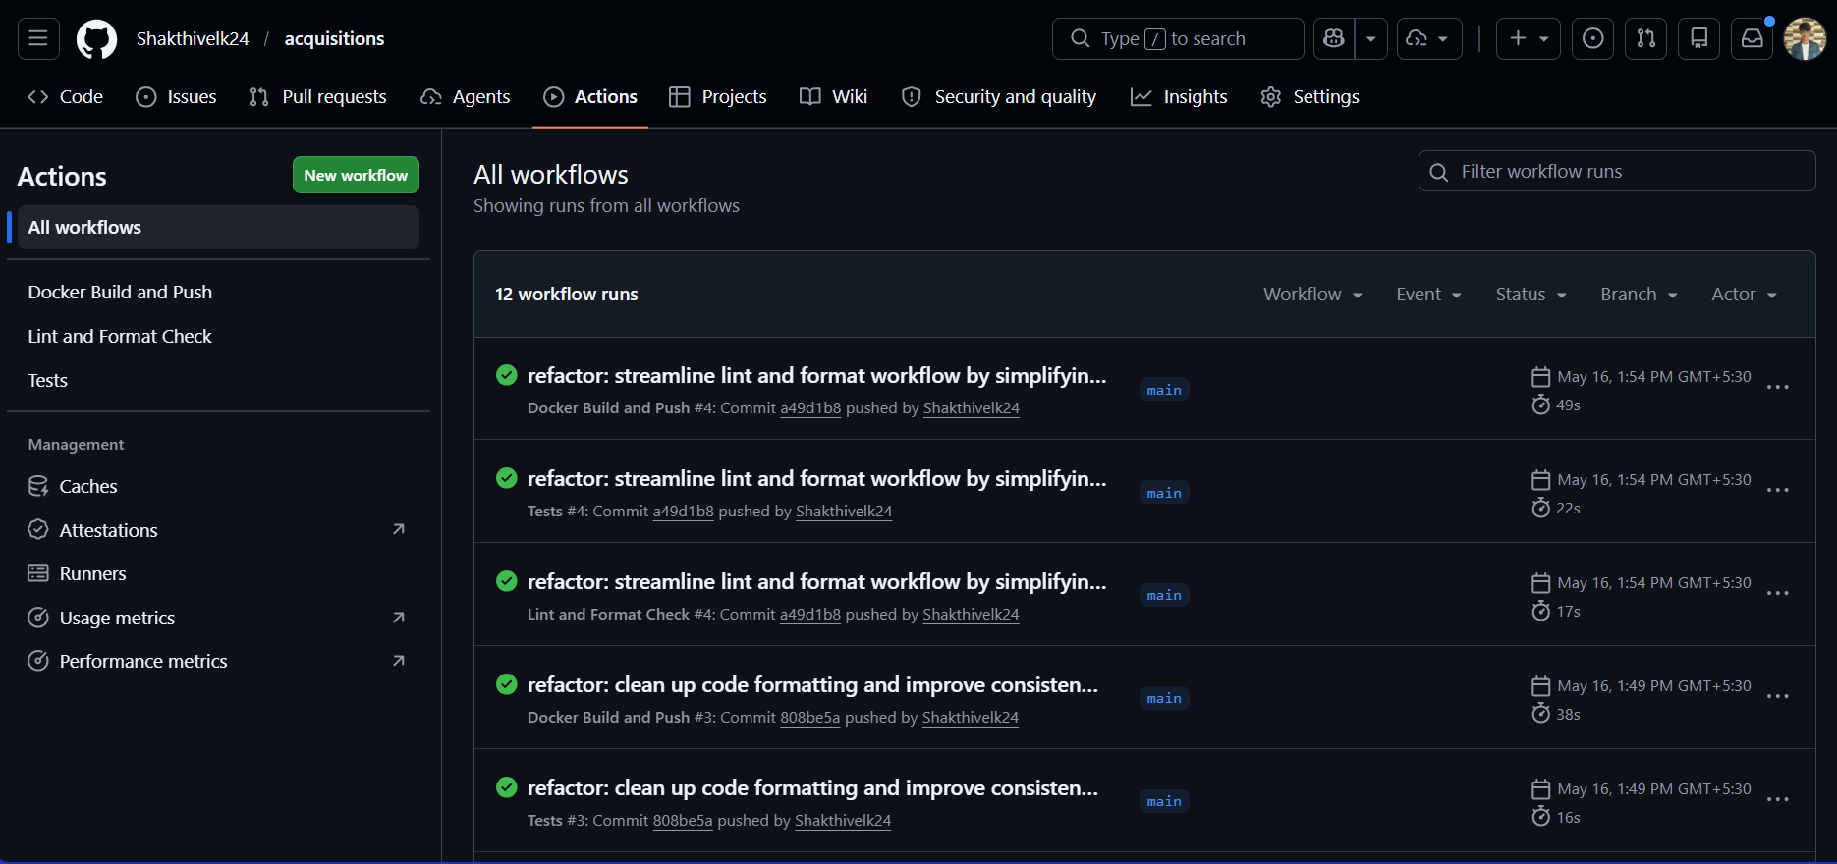
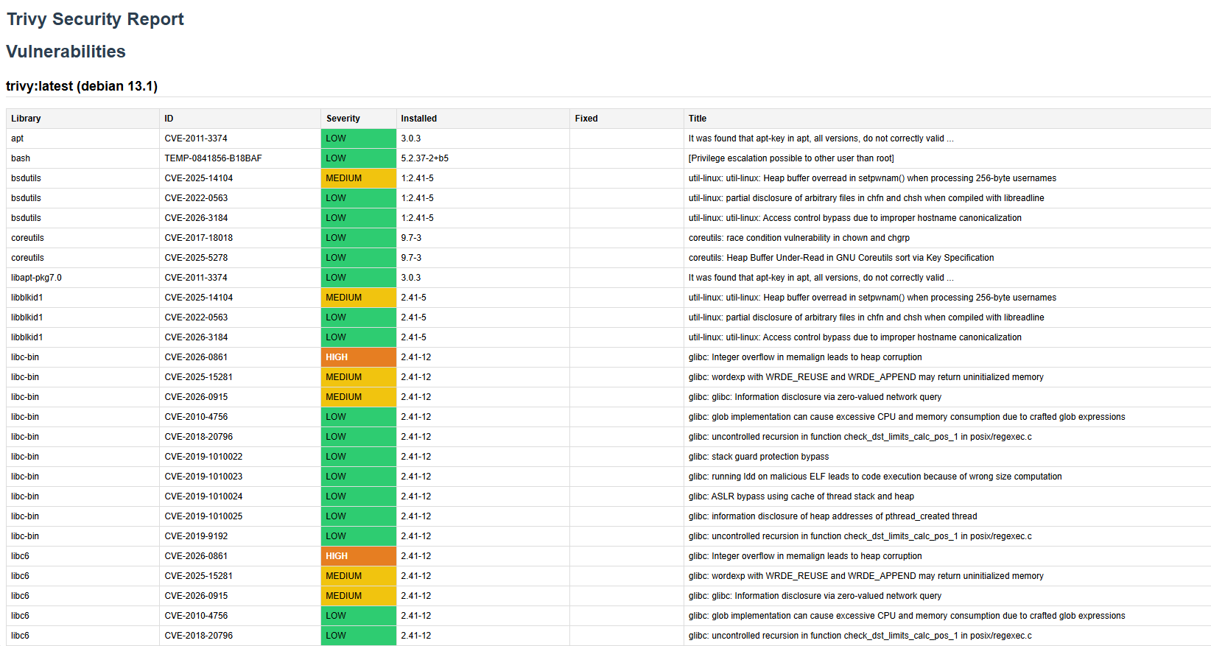
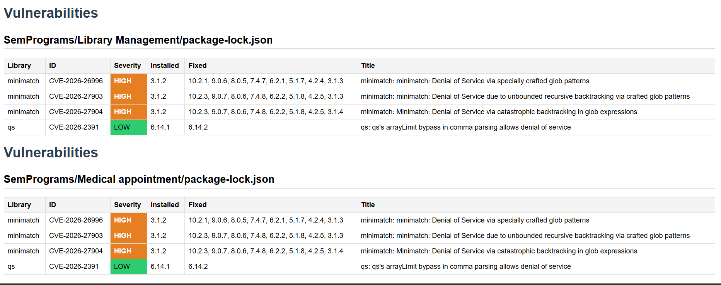
Results and Discussion

Slide 21
Plan of Action for Phase – II
Integrate advanced DevSecOps tools such as Jenkins, SonarQube, OWASP ZAP, Prometheus, and Grafana.
Automate CI/CD pipeline processes including build, testing, and deployment.
Implement Static Application Security Testing (SAST) and Dynamic Application Security Testing (DAST).
Add real-time monitoring, alert management, and performance analysis features.
Deploy the application on cloud platforms like AWS or Azure for better scalability.
Use Docker and Kubernetes for containerization and orchestration.
Enhance the system with AI-based threat detection and automated vulnerability analysis.
Improve overall automation, security, scalability, reliability, and continuous monitoring of the Secure DevOps pipeline.

Slide 22
Time Line for Phase - II
Week | Description
July 2026: Week 1 | Secure DevOps setup and CI/CD configuration
July 2026: Week 2 | Integration of DevSecOps tools such as Jenkins, SonarQube, and OWASP ZAP
July 2026: Week 3 | Automated security scanning and vulnerability testing
July 2026: Week 4 | Pipeline integration testing and validation
August 2026: Week 5 | Performance monitoring setup using Prometheus and Grafana
August 2026: Week 6 | Final documentation and report preparation
August 2026 ……. | Submission of manuscript to an Indexed Journal
September 2026 ……. | Processing of submitted manuscript
October 2026 ……. | Journal review outcome and publication process completion

Slide 23
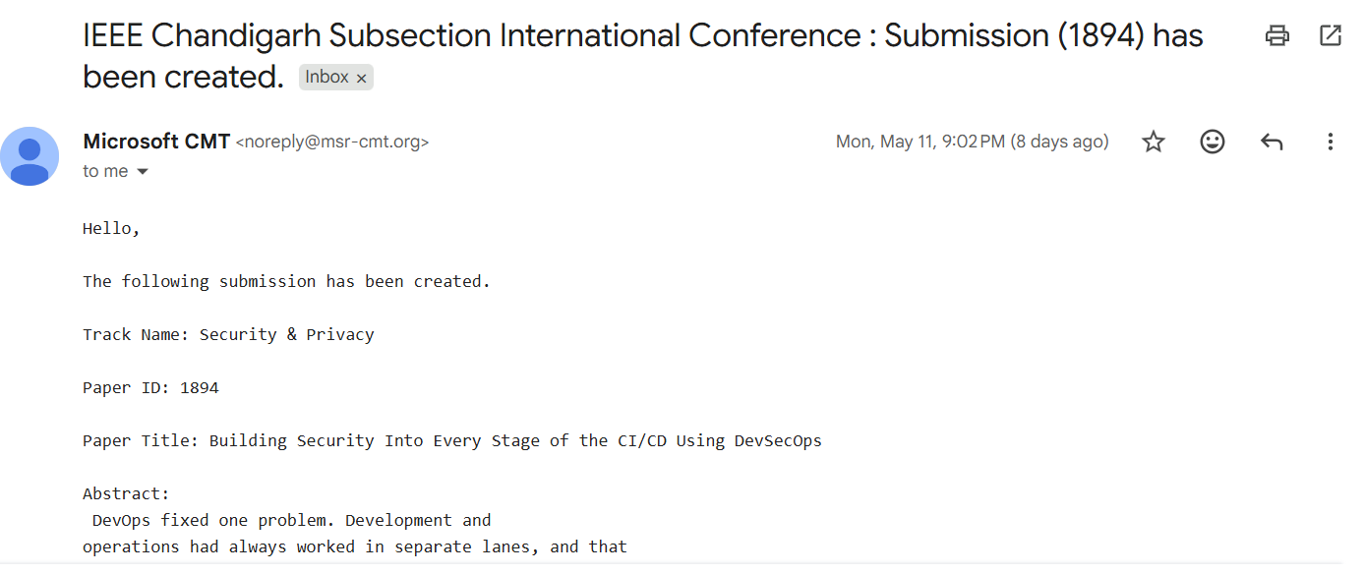

Slide 24
Conclusion
The proposed Secure DevSecOps CI/CD pipeline integrates development, security testing, automated deployment, and monitoring into a single workflow.
By using tools like Jenkins, SonarQube, OWASP ZAP, Docker, and Kubernetes, the system improves software security, deployment speed, and reliability.
Continuous monitoring with Prometheus and Grafana ensures better performance, quick issue detection, and secure application delivery.

Slide 25
References
[1] Mohammad A. Aljohani, Sultan S. Alqahtani, A Unified Framework for Automating Software Security Analysis in DevSecOps, 2023 International Conference on Smart Computing and Application (ICSCA 2023), DOI: 10.1109/ICSCA57840.2023.10087568, ISBN: 979-8-3503-4705-0, 2023.
[2] Lyuben Asenov Nikolov, Adelina Plamenova Aleksieva-Petrova, Action Research on the DevSecOps Pipeline, 2023 International Scientific Conference on Computer Science (COMSCI 2023), DOI: 10.1109/COMSCI59259.2023.10315920, ISBN: 979-8-3503-2525-6, 2023.
[3] Manohar Marandi, A. Bertia, Salaja Silas, Implementing and Automating Security Scanning to a DevSecOps CI/CD Pipeline, 2023 World Conference on Communication & Computing (WCONF 2023), Raipur, India, DOI: 10.1109/WCONF58270.2023.10235015, ISBN: 979-8-3503-1120-4, July 2023.
[4] Nalini M. K., Mahalakshmi B. S., Nevya Khandelwal, Nandan Pai, Sharan L., CI/CD Pipeline with Vulnerability Mitigation, 2023 International Conference on Recent Advances in Science and Engineering Technology (ICRASET 2023), DOI: 10.1109/ICRASET59632.2023.10419921, ISBN: 979-8-3503-0692-7, 2023.

Slide 26
References
[5] Markus Voggenreiter, Florian Angermeir, Fabiola Moyón, Ulrich Schöpp, Pierre Bonvin, Automated Security Findings Management: A Case Study in Industrial DevOps, 46th International Conference on Software Engineering: Software Engineering in Practice (ICSE-SEIP 2024), DOI: 10.1145/3639477.3639744, ISBN: 979-8-4007-0501-4, April 2024.
[6] Akalanka Nayanajith, Ruwan Wickramarachchi, Challenges Affecting the Successful Adoption of DevOps Practices: A Systematic Literature Review, 4th International Conference on Advanced Research in Computing (ICARC 2024), DOI: 10.1109/ICARC61713.2024.10499735, ISBN: 979-8-3503-8486-4, 2024.
[7] Samridhi Jain, Puneet Kumar, DevOps Practices into Machine Learning, 2024 IEEE International Conference on Intelligent Systems, Smart and Green Technologies (ICISSGT 2024), DOI: 10.1109/ICISSGT58904.2024.00029, ISBN: 979-8-3503-0432-9, 2024.
[8] Semi Yulianto, Gerard Nathaniel Cac Ngo, Enhancing DevSecOps Pipelines with AI-Driven Threat Detection and Response, 2024 International Conference on ICT for Smart Society (ICISS 2024), DOI: 10.1109/ICISS62896.2024.10751269, ISBN: 979-8-3503-8965-4, 2024.

Slide 27
References
[9] Fabiola Moyón, Florian Angermeir, Daniel Mendez, Industrial Challenges in Secure Continuous Development, 46th International Conference on Software Engineering: Software Engineering in Practice (ICSE-SEIP 2024), Lisbon, Portugal, April 2024, DOI: 10.1145/3639477.3639736, ISBN: 979-8-4007-0501-4.
[10] Muhammad Zohaib, Ahmed Alsanad, Areej Abdullah Alhogail, Prioritizing DevOps Implementation Guidelines for Sustainable Software Projects, IEEE Access, vol. 12, pp. 71109–71130, 2024, DOI: 10.1109/ACCESS.2024.3402832.
[11] Nghia Dinh, Vinh Truong Hoang, Bay Nguyen Van, Thien Ho Huong, Ha Duong Thi Hong, Hau Nguyen Trung, Kiet Tran Trung, Enhancing Smart Contract Security Through DevSecOps: An Adaptive Approach for Vulnerability Detection, IEEE Access, vol. 13, pp. 159454–159520, 2025, DOI: 10.1109/ACCESS.2025.3606572.
[12] Rashmi Ashtagi, Yash Bhalerao, Chirag Belani, Prasanna Bhalerao, Atharva Chawle, Building Resilient CICD Pipelines: A DevOps Security-First Framework, 2025 International Conference on Computational, Communication and Information Technology (ICCCIT 2025), DOI: 10.1109/ICCCIT62592.2025.10927871, ISBN: 979-8-3315-1296-5, 2025.

Slide 28
References
[13] Roberto Carlos Bautista Ramos, Sang Guun Yoo, Cybersecurity in DevOps Environments: A Systematic Literature Review, IEEE Access, vol. 13, pp. 191959–191980, 2025, DOI: 10.1109/ACCESS.2025.3582892.
[14] Rania Rajab, Mouhib Alnoukari, DevOps Integration With Capability Model Maturity Integration: A Systematic Mapping Review, IEEE Access, vol. 13, pp. 31829–31840, 2025, DOI: 10.1109/ACCESS.2025.3542630.
[15] Sadaquat Ali Ruk, Yasir Mahmood, Azri Azmi, Nurulhuda Firdaus Mohd Azmi, Sehar Gul, Effort Estimation in Agile and DevOps: A Systematic Literature Review of Stakeholder Dissatisfaction, IEEE Access, vol. 13, pp. 167925–167960, 2025, DOI: 10.1109/ACCESS.2025.3600321.
[16] Muhammad Azeem Akbar, Abeer Abdulaziz Alsanad, Empirical Investigation of Key Enablers for Secure DevOps Practices, IEEE Access, vol. 13, pp. 43698–43710, 2025, DOI: 10.1109/ACCESS.2025.3549183.
[17] Junaid Nasir Qureshi, Muhammad Shoaib Farooq, Usman Ali, Adel Khelifi, Zabihullah Atal, Exploring the Integration of Blockchain and Distributed DevOps for Secure, Transparent, and Traceable Software Development, IEEE Access, vol. 13, pp. 15489–15500, 2025, DOI: 10.1109/ACCESS.2024.3509036.

Slide 29
References
[18] Nagasundari S, Pratham Manja, Priyansh Mathur, Prasad B. Honnavalli, Extensive Review of Threat Models for DevSecOps, IEEE Access, vol. 13, pp. 45252–45274, 2025, DOI: 10.1109/ACCESS.2025.3547932, 2025.
[19] Jafar Ababneh, Esam Y. A. Al-Nsour, Alaa’a Al-Shaikh, Mohammad Rasmi Al-Mousa, Ahmad Al-Zabin, Mahmoud Asassfeh, Hasan Abualese, Enhancing DevOps Continuous Monitoring Phase: Hybrid Intrusion Detection and Ensemble Learning System (HIDELS), IEEE Access, vol. 14, pp. 4733–4755, 2026, DOI: 10.1109/ACCESS.2026.3650793.
[20] Ahmad Alnafessah, Alim Ul Gias, Runan Wang, Lulai Zhu, Giuliano Casale, Antonio Filieri, Quality-Aware DevOps Research: Where Do We Stand?, IEEE Access, vol. 9, pp. 44476–44489, 2021, DOI: 10.1109/ACCESS.2021.3064867.

Slide 30
Q & A

Slide 31
Thank You

